Slide 1
Gender equality in research organization in Latvia: Achievements and Challenges
Anna Leiškalne
Department of Higher Education, Science and Innovation
Ministry of Education and Science of the Republic of Latvia
18.03.2019

Slide 2
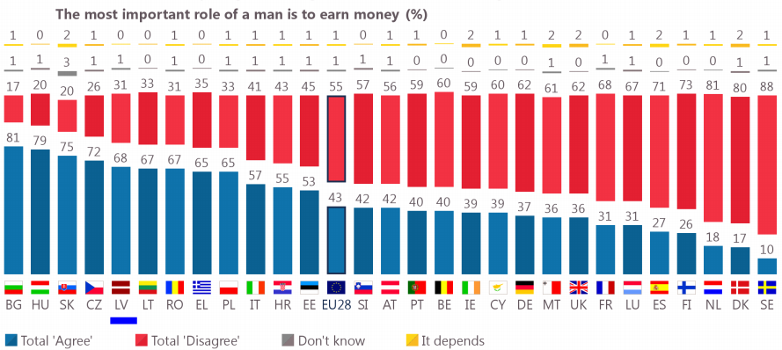
Background data about Latvia and gender equality (I)
Opinions in Latvia on gender roles most likely put a pressure on men to be the bread winner
Source: Special Eurobarometer 465

Slide 3
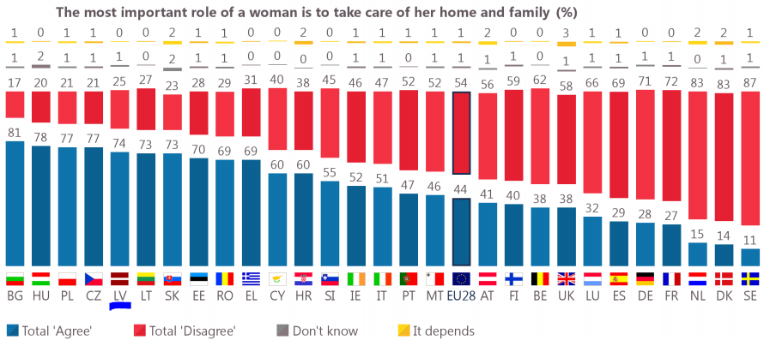
Background data about Latvia and gender equality (II)
Majority of Latvians view a woman primarily as a caregiver based on her most important role
Source: Special Eurobarometer 465

Slide 4
Background data about Latvia and gender equality (III)
Women far outnumber men in Latvia and is #1 country in EU by women per 100 men

Slide 5




Key facts about research in Latvia
77 research institutions
(21 state funded research institutions)
58% of PhD graduates are women
(EU– 48%; LV (2007) – 60%);
51% of researchers are women
(EU – 33.4%)
Develop the public research
& education system by
reducing fragmentation,
strengthening
R&I capacity, and
internationalization
11 028 R&D personnel
(5 378 in FTE)
15 % work in the industry
In 2017, 137.9 million EUR
was invested in R&D (0.51% of GDP)
(the target goal in 2020 is 1.5%)
~30 % of companies
are active in innovations
Notes:
More than 20 000 students in 2017/18 academic year are studying in STEM fields (Natural Sciences and Engineering)
In the 2017/18 academic year,
foreign students constitute 11% of
all students in Latvia (constant
increase over previous years)
PhD graduates in ICT (25% women); 38% in engineering;
Proportion of women among researchers: LV is #1 in EU
~ 54,6% of R&D personnel (HC) are female

Slide 6
Human resources in science
In Latvia researchers as a share of total employment is 2 times smaller compaired to EU average,
indicating a crucial lack of human resources in science and a substantial obstacle for ensuring sufficient science capacity
Researchers (FTE) as share of total employment in country (2016)
Notes:
Riga Technical Uni strategy 2014-2020: «weaknesses: Limited financial resources and human resources ; Lack of competition for announced academic
staff vacancies ; Threats: Unfavourable demographic situation in the country, migration and outflow of human intellectual potential to other parts of the world n Inconsistent and low-percentage public funding for higher education and science n Underestimated role of tertiary education in the society »

Slide 7
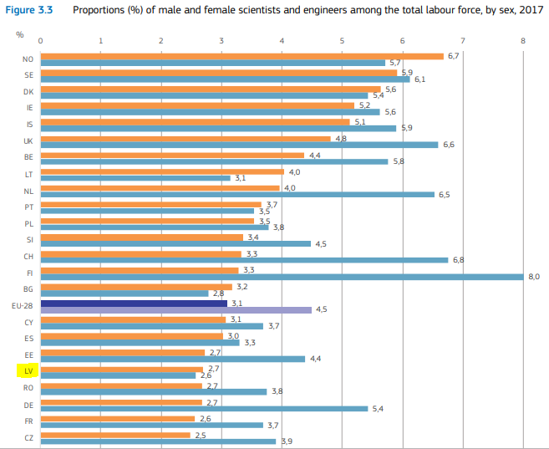
Human resources in science by sex
Proportion of scientists
& engineers in LV is
below the EU average.
However the difference
between genders
is relatively low
(less than 0,5 percentage points)
    The gender pay gap in the economic activity ‘Scientific research & development’
    is lower in LV (16,5%) than in EU (17%)
Source: She Figures 2018
Notes:
This data might support the ERA reported that in Latvia the high % of female scientists is just a coincidence and a result from a demographics in the country

Slide 8

Science finance in Latvia
Science in Latvia has been underfinanced for at least over a decade
Notes:
Under financing science means loosing (or never gaining) a prestige and recognition science needs for a healthy competitiveness, which means that those who can will most likely search for a job in a not-science related field for earning more (or enough) or just emigrate for a science related job elsewhere.

Slide 9
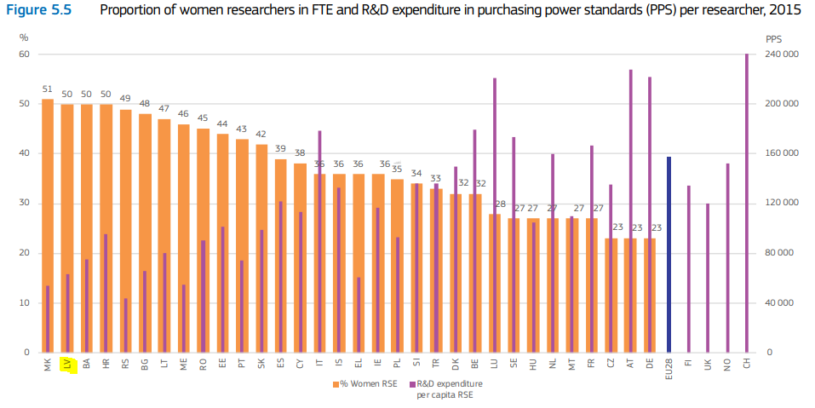
Expenditure on R&D and women researchers
Source: She Figures 2018
Notes:
So if there is a connection between R&D funding and proportion of women researchers then Latvia is heading towards a decrease of women researchers in future by increasing science finance resources.
This graph reveals that a high proportion of women researchers might correlate to expenditure in R&D. The question here is: if the expenditure in LV grows, would proportion of women reduce? If so, this is a sign of lack of GE in LV science and that the data that shows just proportion of women creates a veil of supposed GE in science in LV.

Slide 10
Ecosystem of science in Latvia
Latvia's research priorities
Smart specialization
Policy documents
Fundamental and applied research
State research program tender
Market oriented research
Eu structural fund programmes (incl. practical research and postdocs)
Society
Industry representatives
Knowledge base & human capital in all science fields
State research programmes (MoES, other ministries)
Strengthening capacity & knowledge transfer, innovations
Professional associations
ECONOMIC GROWTH

Slide 11




Future actions for implementation of GE in R&D
Incorporating
a gender equality dimension
in implementation of research projects
Fundamental changes: increasing science finance & strengthening R&I capacity
Science communication:
promoting research and prestige of scientific work
Developing a strategy & financial stimulus for research organizations to ensure
gender equality in science
Developing & implementing a gender equality plan in research institutions’ strategies
Notes:
https://izm.gov.lv/lv/latvijas-zinatnes-kalendars-2019

Slide 12
Thank you for your attention!

